Slide 1
Chapter 4
Lexical and Syntax Analysis

Slide 2
Chapter 4 Topics
Introduction
Lexical Analysis
The Parsing Problem
Recursive-Descent Parsing
Bottom-Up Parsing
Copyright © 2012 Addison-Wesley. All rights reserved.
1-<number>

Slide 3
Introduction
Language implementation systems must analyze source code, regardless of the specific implementation approach
Nearly all syntax analysis is based on a formal description of the syntax of the source language (BNF)
Copyright © 2012 Addison-Wesley. All rights reserved.
1-<number>

Slide 4
Syntax Analysis
The syntax analysis portion of a language processor nearly always consists of two parts:
  A low-level part called a lexical analyzer (mathematically, a finite automaton based on a regular grammar)
  A high-level part called a syntax analyzer, or parser (mathematically, a push-down automaton based on a context-free grammar, or BNF)
Copyright © 2012 Addison-Wesley. All rights reserved.
1-<number>

Slide 5
Advantages of Using BNF to Describe Syntax
Provides a clear and concise syntax description
The parser can be based directly on the BNF
Parsers based on BNF are easy to maintain
Copyright © 2012 Addison-Wesley. All rights reserved.
1-<number>

Slide 6
Reasons to Separate Lexical and Syntax Analysis
Simplicity - less complex approaches can be used for lexical analysis; separating them simplifies the parser
Efficiency - separation allows optimization of the lexical analyzer
Portability - parts of the lexical analyzer may not be portable, but the parser always is portable
Copyright © 2012 Addison-Wesley. All rights reserved.
1-<number>

Slide 7
Lexical Analysis
A lexical analyzer is a pattern matcher for character strings
A lexical analyzer is a “front-end” for the parser
Identifies substrings of the source program that belong together - lexemes
  Lexemes match a character pattern, which is associated with a lexical category called a token
  sum is a lexeme; its token may be IDENT
Copyright © 2012 Addison-Wesley. All rights reserved.
1-<number>

Slide 8
Example
result = oldsum – value / 100;
Token Lexeme
IDENT result
ASSIGN_OP =
IDENT oldsum
SUB_OP -
IDENT value
DIV_OP /
INT_LIT 100
SEMICOLON ;
Copyright © 2012 Addison-Wesley. All rights reserved.
1-<number>

Slide 9
Lexical Analysis (continued)
The lexical analyzer is usually a function that is called by the parser when it needs the next token
Three approaches to building a lexical analyzer:
  Write a formal description of the tokens and use a software tool that constructs a table-driven lexical analyzer from such a description
  Design a state diagram that describes the tokens and write a program that implements the state diagram
  Design a state diagram that describes the tokens and hand-construct a table-driven implementation of the state diagram
Copyright © 2012 Addison-Wesley. All rights reserved.
1-<number>

Slide 10
State Diagram Design
  A naïve state diagram would have a transition from every state on every character in the source language - such a diagram would be very large!
Copyright © 2012 Addison-Wesley. All rights reserved.
1-<number>

Slide 11
Lexical Analysis (continued)
In many cases, transitions can be combined to simplify the state diagram
  When recognizing an identifier, all uppercase and lowercase letters are equivalent
    Use a character class that includes all letters
  When recognizing an integer literal, all digits are equivalent - use a digit class
Copyright © 2012 Addison-Wesley. All rights reserved.
1-<number>

Slide 12
Lexical Analysis (continued)
Reserved words and identifiers can be recognized together (rather than having a part of the diagram for each reserved word)
  Use a table lookup to determine whether a possible identifier is in fact a reserved word
Copyright © 2012 Addison-Wesley. All rights reserved.
1-<number>

Slide 13
Lexical Analysis (continued)
Convenient utility subprograms:
  getChar - gets the next character of input, puts it in nextChar, determines its class and puts the class in charClass
  addChar - puts the character from nextChar into the place the lexeme is being accumulated, lexeme
  lookup - determines whether the string in lexeme is a reserved word (returns a code)
Copyright © 2012 Addison-Wesley. All rights reserved.
1-<number>

Slide 14
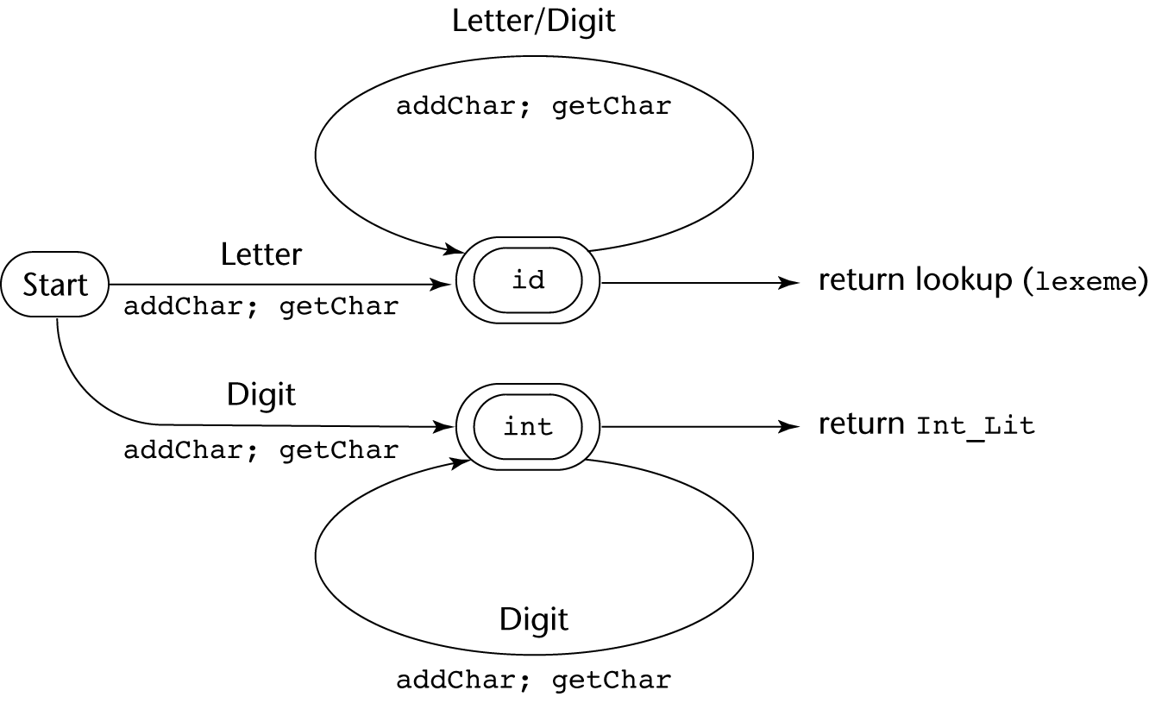
State Diagram
Copyright © 2012 Addison-Wesley. All rights reserved.
1-<number>

Slide 15
Lexical Analyzer
Implementation:
→ SHOW front.c (pp. 172-177)
- Following is the output of the lexical analyzer of
front.c when used on (sum + 47) / total
Next token is: 25 Next lexeme is (
Next token is: 11 Next lexeme is sum
Next token is: 21 Next lexeme is +
Next token is: 10 Next lexeme is 47
Next token is: 26 Next lexeme is )
Next token is: 24 Next lexeme is /
Next token is: 11 Next lexeme is total
Next token is: -1 Next lexeme is EOF
Copyright © 2012 Addison-Wesley. All rights reserved.
1-<number>

Slide 16
The Parsing Problem
Goals of the parser, given an input program:
  Find all syntax errors; for each, produce an appropriate diagnostic message and recover quickly
  Produce the parse tree, or at least a trace of the parse tree, for the program
Copyright © 2012 Addison-Wesley. All rights reserved.
1-<number>

Slide 17
The Parsing Problem (continued)
Two categories of parsers
  Top down - produce the parse tree, beginning at the root
    Order is that of a leftmost derivation
    Traces or builds the parse tree in preorder
  Bottom up - produce the parse tree, beginning at the leaves
    Order is that of the reverse of a rightmost derivation
Useful parsers look only one token ahead in the input
Copyright © 2012 Addison-Wesley. All rights reserved.
1-<number>

Slide 18
The Parsing Problem (continued)
Top-down Parsers
  Given a sentential form, xAα , the parser must choose the correct A-rule to get the next sentential form in the leftmost derivation, using only the first token produced by A
The most common top-down parsing algorithms:
  Recursive descent - a coded implementation
  LL parsers - table driven implementation
Copyright © 2012 Addison-Wesley. All rights reserved.
1-<number>

Slide 19
The Parsing Problem (continued)
Bottom-up parsers
  Given a right sentential form, α, determine what substring of α is the right-hand side of the rule in the grammar that must be reduced to produce the previous sentential form in the right derivation
  The most common bottom-up parsing algorithms are in the LR family
Copyright © 2012 Addison-Wesley. All rights reserved.
1-<number>

Slide 20
The Parsing Problem (continued)
The Complexity of Parsing
  Parsers that work for any unambiguous grammar are complex and inefficient ( O(n³), where n is the length of the input )
  Compilers use parsers that only work for a subset of all unambiguous grammars, but do it in linear time ( O(n), where n is the length of the input )
Copyright © 2012 Addison-Wesley. All rights reserved.
1-<number>

Slide 21
Bottom-Up Example
S → aAc
A → aA | b
S => aAc => aaAc => aabc
Bottom-Up:
  aabc —> b should be A
  aaAc —> aA should be A
  aAc —> aAc should be S
  S
Copyright © 2012 Addison-Wesley. All rights reserved.
1-<number>

